Slide 1
FINAL PROJECT PRESENTATION Simple Socket Chat Application
PRESENTED BY
NALIANYA KEVIN
SCT121-D1-0010/2023

Slide 2
INTRODUCTION
A simple chat application enables communication and exchange of messages between clients and servers by utilizing synchronous information exchange. this is achieved by socket programming that enables programs to connect and exchange information at the socket level.
The aim of this project is to design and develop a simple chat application that implements sockets

Slide 3
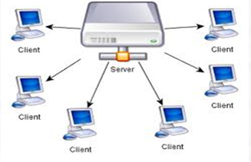
LITERATURE REVIEW
This chapter deals with the review of literature related to the system being developed. It also shows the current state of knowledge based on system being developed. includes:
server- which is a system that responds to requests from clients
client- which is a system that requests resources from the server.
socket - which is the endpoint that provides link for connection between the client and the server.
synchronous chats- this is form of communication where aserver is able to serve multiple users. include; web based chat rooms and real time chats.
asychronous chats- where a server is only capable of handling a single user at atime.

Slide 4
REQUIREMENTS AND ANALYSIS
System Requirements.- This chapter outlines system requirements and specifications.
Network requirement- there must be connection between the server and the client through the internet. a local host is used for the purpose of testing.
hardware components- the server computer should have higher processing speed ie corei 5, and large RAM of 8gb to serve the connected users efficiently. the clients also recommended to have higher specifications.
Software Requirements- server to have server running operating system and client also to have stable running operating system. VS code development environment needed for source code development and testing purposes.
Functional Requirements. the client and server should be able to connect , and communicate to share and exchange messages.
Operating Environment- the application can be operated on both windows or linux operated systems.

Slide 5
Summary of tools requirement and estimated prices in Kenya shillings
software and hardware requirements.
Microsoft Visual
Internet connection
Hardware Requirements | Price(KSH) | Software Requirements | Price(KSH) | Other | Price(KSH)
2 Laptops or PC | 70000 | Windows 10 installed in both laptops | NULL | Skills | NULL
4 GB Flash disk | 1000 | Studio | NULL |  | NULL
DVD’s and CD’s | 100 | QT software | NULL | Data Bundles | 1000
500 GB External Hard-Disk | 5000
4G Modem | 3000

Slide 6
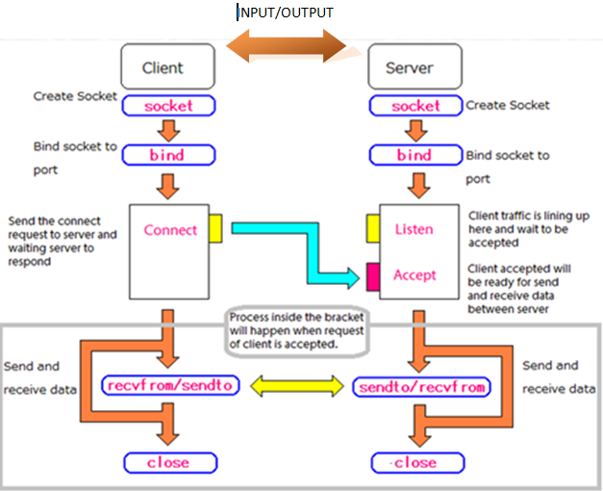
SYSTEM DESIGN
Design Considerations- the system need to reliable and maintainable.
User Interface Design- design and interface that the user will to interact with the system
Data Flow diagram for the Proposed System- this shows how data is logically shared between the systems in the application.
Entities identified included the following: server, client, messages.
Code design/Networking- this include produres and algorithms used in the communication process.
Input Design/Output Design.

Slide 7
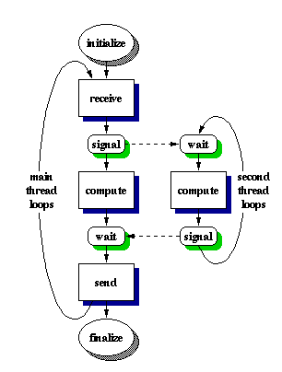
SYTSTEM IMPLIMENTATION
this involves converting the design into an operating application. and is set to achieve the following;
how the application should be build into a physical system
ensuring that the chat application is operational and in use.
C# programming language was used to implement creation of the source code for both client and server application.

Slide 8
THE TESTING PHASE
Testing objectives:
•To determine whether the system can carry its required objectives without breakdown
•To determine errors, faults and malfunctioning of the system.
•To give a clear operation of the system towards attaining the user needs.
•To see if the intended new system meets both user and system requirements.

Slide 9
EVALUATION
To evaluate this software application the key areas to look are:
•Performance- the perfomance were tested and the client and server were able to connect and share information.
•Security- for project testing purposes was not able to invest much in security design.
•Usability- the project when build to .exe file was able to run on windows and easy to use and interact with.
•Expected requirements met and not met- met basic design requirements though there was some challenges in implementing some of the application functions.
•Quality of app- the app had good appearance and managed to achieve some functions.
.

Slide 10
CONCLUSIONS
The phases taken to build this simple application implementing sockets were a stepping to learn so much about sockets.
Networking principles were covered that is TCP /IPv4 sockets on which this project relied so much.
Socket programming in C# was applied on building this project. later advancements will involve use of other languages to bring out the GUI and other elements which I could not achieve in C# which was only for project purposes.
Data structures and functions encountered were, socket (), bind (), connect (), listen (), accept and they formed a bigger role in making this application.
Socket programming is mainly implemented in distributed systems to allow programs to communicate with each other.
.

Slide 11
RECOMMENDATIONS AND FUTURE WORK
The recommendation for future development of this application is this:
•A highly effective, responsive Graphical user interface (GUI)
•Multithreaded server application (Non-Blocking server)
•Better research in other languages like python, php, C++ and UNIX sockets to see which makes it better
•Team development of this application from scratch.
•Development of Advanced Sockets application
•Implement a dedicated server where many clients can connect to.
END OF PRESENTATION
-

